Slide 1

New Board Member Gathering
Webinar
Taking Office as a School Board Member
Presented by the WASB Legal Services Staff

Slide 2

Welcome and thank you!
How you can reach the WASB with your questions and comments:
www.wasb.org
info@wasb.org
Call WASB by phone, toll-free, at
1-877-705-4422

Slide 3
You’ve won the election … what happens next?
A “Certificate of Election” should be issued by the school board clerk.
You must take and file the written oath of office on or before the 4th Monday in April.
(NOTE: Taking the oath a second time for purely “ceremonial” purposes at a later school board meeting is OK).
Regular terms start on the 4th Monday in April.

Slide 4
Get your bearings and find some direction!
Use the time between the election and taking office for orientation-type activities
Some school boards have an established orientation process for new members
In some school districts, the process is very informal

Slide 5
Review some of the key documents through which the school board governs
The strategic plan and the board’s priority goals
School board policies
The annual budget
The district administrator’s contract and job description
Handbooks/Collective bargaining agreements

Slide 6


Attending board meetings before the start of your term
Open session meetings
Closed session meetings

Slide 7

The school board’s annual organizational meeting
Election of board officers
Committee appointments
Other common items of business

Slide 8
School Board Duties and Powers
§120.12 of the state statutes enumerates a list of specific duties of a school board.
§120.13 of the state statutes enumerates a list of specific powers of a school board.
§120.10 of the state statutes enumerates a list of specific powers of an annual meeting (which, for unified school districts, are powers of the school board).
§120.44(2) of the state statutes gives unified school districts the powers and duties of the common school board and annual meeting.
Other statutes (particularly in chapters 118, 120, and 121) create other powers and duties.
Notes:
8

Slide 9

Board Job Description
Provide general oversight for administration and district.
Hire and evaluate District Administrator.
Review board policies and update as needed.
Adopt a budget and allocate resources consistent with board priorities and district goals.
Oversee negotiation and administration of critical contracts.
Be advocates for the district in the community and at the state, federal and other local governments.
Make strategic decisions.

Slide 10
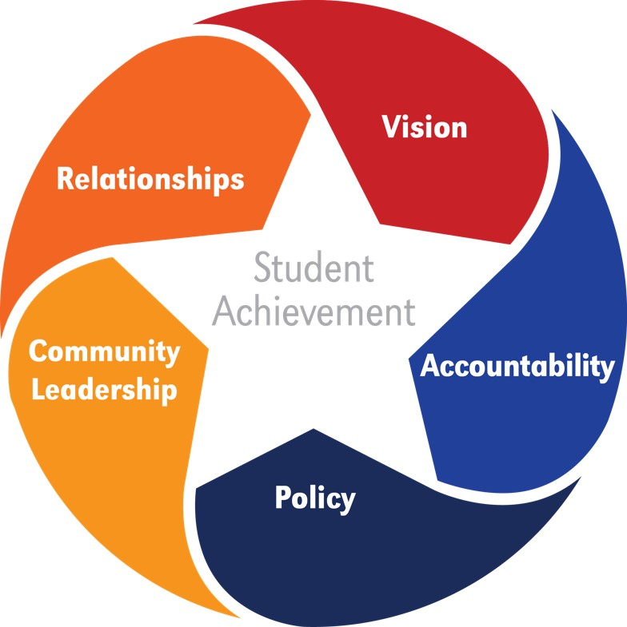
The Key Work of School Boards
Key Works of School Boards: NSBA has identified the core skills that effective boards need to ensure that all students achieve at high levels.

Slide 11

Board Roles: Vision
Your vision reflects a mental picture of the most successful schools and district that you could have, centered on outstanding student achievement.
  Effective school boards establish a clear vision and high expectations for quality teaching and learning that supports strong student outcomes.
  School boards achieve their vision by:
    developing a strategic plan guided by the vision
    Establishing/approving goals that support the vision
    making budgetary decisions and allocating resources in a manner that is aligned with the school district’s vision and goals
    Attending to the other elements of the Key Work of School Boards (e.g., adopting policies that support and implement the vision/goals and that establish structural accountability.

Slide 12
Board Roles: Accountability
Accountability means measuring and judging how well the district is putting the vision into practice and making progress on key goals.
Accountability starts with (1) the adoption of goals and academic and other standards, and (2) the assignment of responsibility and authority.
Data and other assessments are used as a tool: Success is acknowledged and rewarded, while any lack of success drives change and improvement efforts.
Notes:
Accountability questions:
➢ How do staff and students learn what is expected of them?
➢ How do we ensure that our policy and budget decisions are research-based and datadriven?
➢ Do we have information systems that provides adequate data for accountability?
➢ How do we recognize and reward students, teachers, and schools that meet or exceed student performance standards?

Slide 13

Board Roles: Policy
Boards decide what gets done and what parameters limit what gets done.
Administration decides who does it and how to do it.
The Policy Resource Guide (PRG) is a Web-based policy tool designed to assist Wisconsin school boards and administrators in the important tasks of policy development and implementation.
“Administration’s job is to run the district, the Board’s job is to make sure the district is run well.”

Slide 14


Board Roles:
Community Leadership
School Board Meetings
    Agenda Structure and Content
    Public Comment Period/Discussion Periods
    Connection to Board Policy
    Connection to Board Goals
    BoardDocs ® eGovernance Solutions
    Situation Reports

Slide 15
Board Roles:
Relationships
Board-Superintendent Relationships
  Both the school board and the superintendent have essential leadership roles that are interconnected but different.
  A productive board-superintendent-administration-staff relationship requires each to understand the unique roles and responsibilities of their position.
  In nearly all districts, issues arise that can cause (or should cause) the leadership team to recalibrate their mutual understandings of their respective roles.
  Shared goals and clear policies can help to define roles and build a strong, collaborative relationship. Actions that erode trust harm the relationship and jeopardize the effectiveness of the leadership team.

Slide 16
Examples of board roles through a more legalistic lens…
“Legislative”
Making policy, determining the budget and the tax levy.
“Judicial”
Serving as an impartial decision-maker in a “due process” hearing (finding facts, applying law/policy, reaching conclusions, issuing orders).
“Executive”
Serving as an employer
(hiring, evaluating, compensating).

Slide 17
Conflict of Interest
Overview
Code of ethics for public officials. Wisconsin Statute §§19.41-59
Criminal liability under Wisconsin Statute §946.12 (misconduct in public office) and Wisconsin Statute §946.13 (private interest in public contracts) of the Wisconsin statutes.
Doctrine of incompatible offices. Some exceptions for volunteer positions.
“Common law” conflicts of interest.
Bias and partiality.

Slide 18
Open Meetings Law
Resources
Wisconsin Statutes §§19.81-98
Department of Justice 2015 Open Meeting Law Guide
WASB Open Meetings Law Brochure
WASB Legal Comments, Aug. 2007, May 2006, Sept.-Oct. 2004 (https://wasb.org/; go to “Legal Information” drop-down menu; click on “Legal Comments List.”).

Slide 19
Public Records: Core Concepts for Board Members
Board Member Obligations:
  Because a board member is a local public official, the board member is also the records custodian of his or her records.
    A board member may not individually designate a district employee to serve as the legal custodian of his or her own records (but the board can designate such a custodian under Wisconsin Statute §120.13(28))
  Therefore, board members must:
    Retain their records and be prepared to respond to requests.
  Individual board members are not, however, required to adopt or post a “public records notice.”

Slide 20
Public Records: Core Concepts for Board Members
Board Member Obligations– key considerations (cont.):
  Emails regarding matters within the authority of the board are subject to records retention requirements and are likely subject to release as public records, regardless of whether the email is from a district or personal email account.
  Blogs, social media entries and even text messages can be subject to the public records law.
  Once a records request is received, the record(s) subject to the request may only be destroyed under very limited circumstances.

Slide 21
Public Records: Core Concepts for Board Members
Board Member Obligations – key considerations (cont.):
  Upon receiving a request for a record that has not also been maintained by the board’s records custodian, the board member must respond to the request “as soon as practicable and without delay.”
  Criminal penalties exist for the alteration or falsification of public records, as well as for the destruction, concealment, damage or removal of public records with intent to injure or defraud.
  Board members must pass on any official records of their
  office to their successor.

Slide 22
Public Records:
Suggestions for Board Members
Review your board’s public records notice.
Establish sound practices in regard to the use of email (and for other inter-meeting correspondence) from the start. Strongly consider securing a school email address and using it for all board-related business so that all of your school-related emails are automatically retained by the district’s records’ custodian/server.
If you receive a public records request, review it with your district’s records custodian (and possibly legal counsel) immediately.
Review your board’s related records policies and any retention schedule that the board has approved.

Slide 23
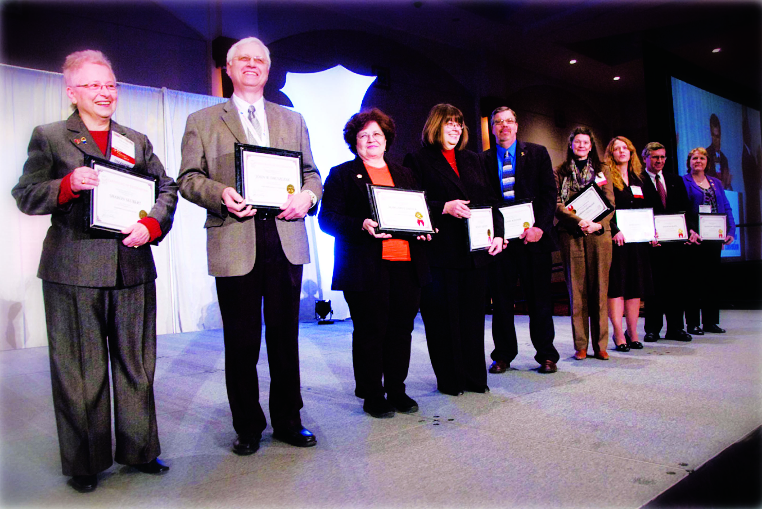
What is the WASB?
A non-profit, voluntary association serving Wisconsin’s 422 school boards and 12 CESA boards of control.

Slide 24

Why Choose the WASB?
Your State Association
Innovative ideas
Timely information.
Legislative advocacy
Essential services
Quality resources
Relevant programs

Slide 25

WASB Areas of Service
Legal Services
Advocacy & Government Relations
Governance & Leadership Development
Policy Services
Superintendent Search Services
Organizational Consulting Services
Communications

Slide 26

Legal Services
Helping you make sound management decisions.
General legal and human resources information
Sample employment policies, compensation data and other resources
Individual, fee-based services

Slide 27

Advocacy & Government Relations
Advocacy that is heard in the Capitol.
A strong voice representing the interests of Wisconsin school boards.
Resources and regular updates to help school board members be the most effective advocates possible.

Slide 28

Governance & Leadership Development
Building effective leadership.
Providing information, tools and support to help boards respond to emerging trends, engage with their communities and foster strong relationships.

Slide 29

Policy Services
From development through implementation.
The Policy Resource Guide (PRG) is a Web-based policy tool designed to assist Wisconsin school boards and administrators in the important tasks of policy development and implementation.
Policy Library, including thousands of sample policies, articles, guidance documents and other resources.

Slide 30

Superintendent Search Service
Helping you find the right match.
Customized search process for each board.
Transition services to help boards and their new administrators begin their journey together.

Slide 31

Organizational Consulting
The WASB provides comprehensive, customized training, support, resources and inspiration to school boards and superintendents to maximize their effectiveness in carrying out their respective leadership roles.

Slide 32
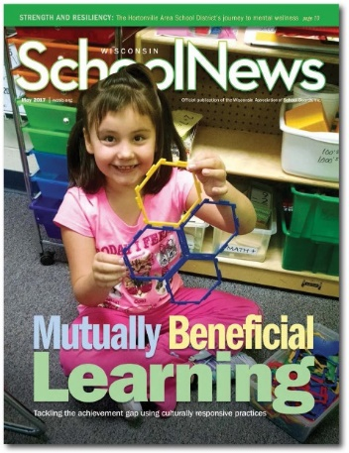

Publications &
Subscriptions
Award-winning magazine
Legislative updates
Policy and legal newsletters
Policy Resource Guide web-based
tool
Model Employee Handbook
Special Issue Publications
and Bulletins

Slide 33

Conferences and Seminars
State Education Convention
Legal and Human Resources Conferences
Legislative Advocacy Conference
Workshops and Webinars
Leadership
Conference
School Law
Conference
Day at the Capitol
Spring Academy
Regional Meetings

Slide 34
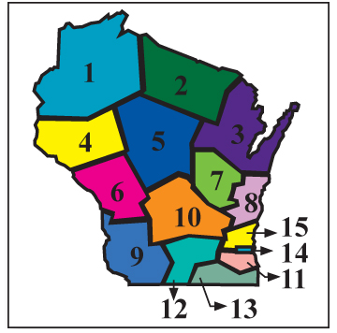
WASB Board of Directors
Each member board has one vote to elect a regional representative to the WASB Board of Directors.
The executive director is responsible for carrying out the policies of the Board of Directors and coordinating Association programs and services.

Slide 35
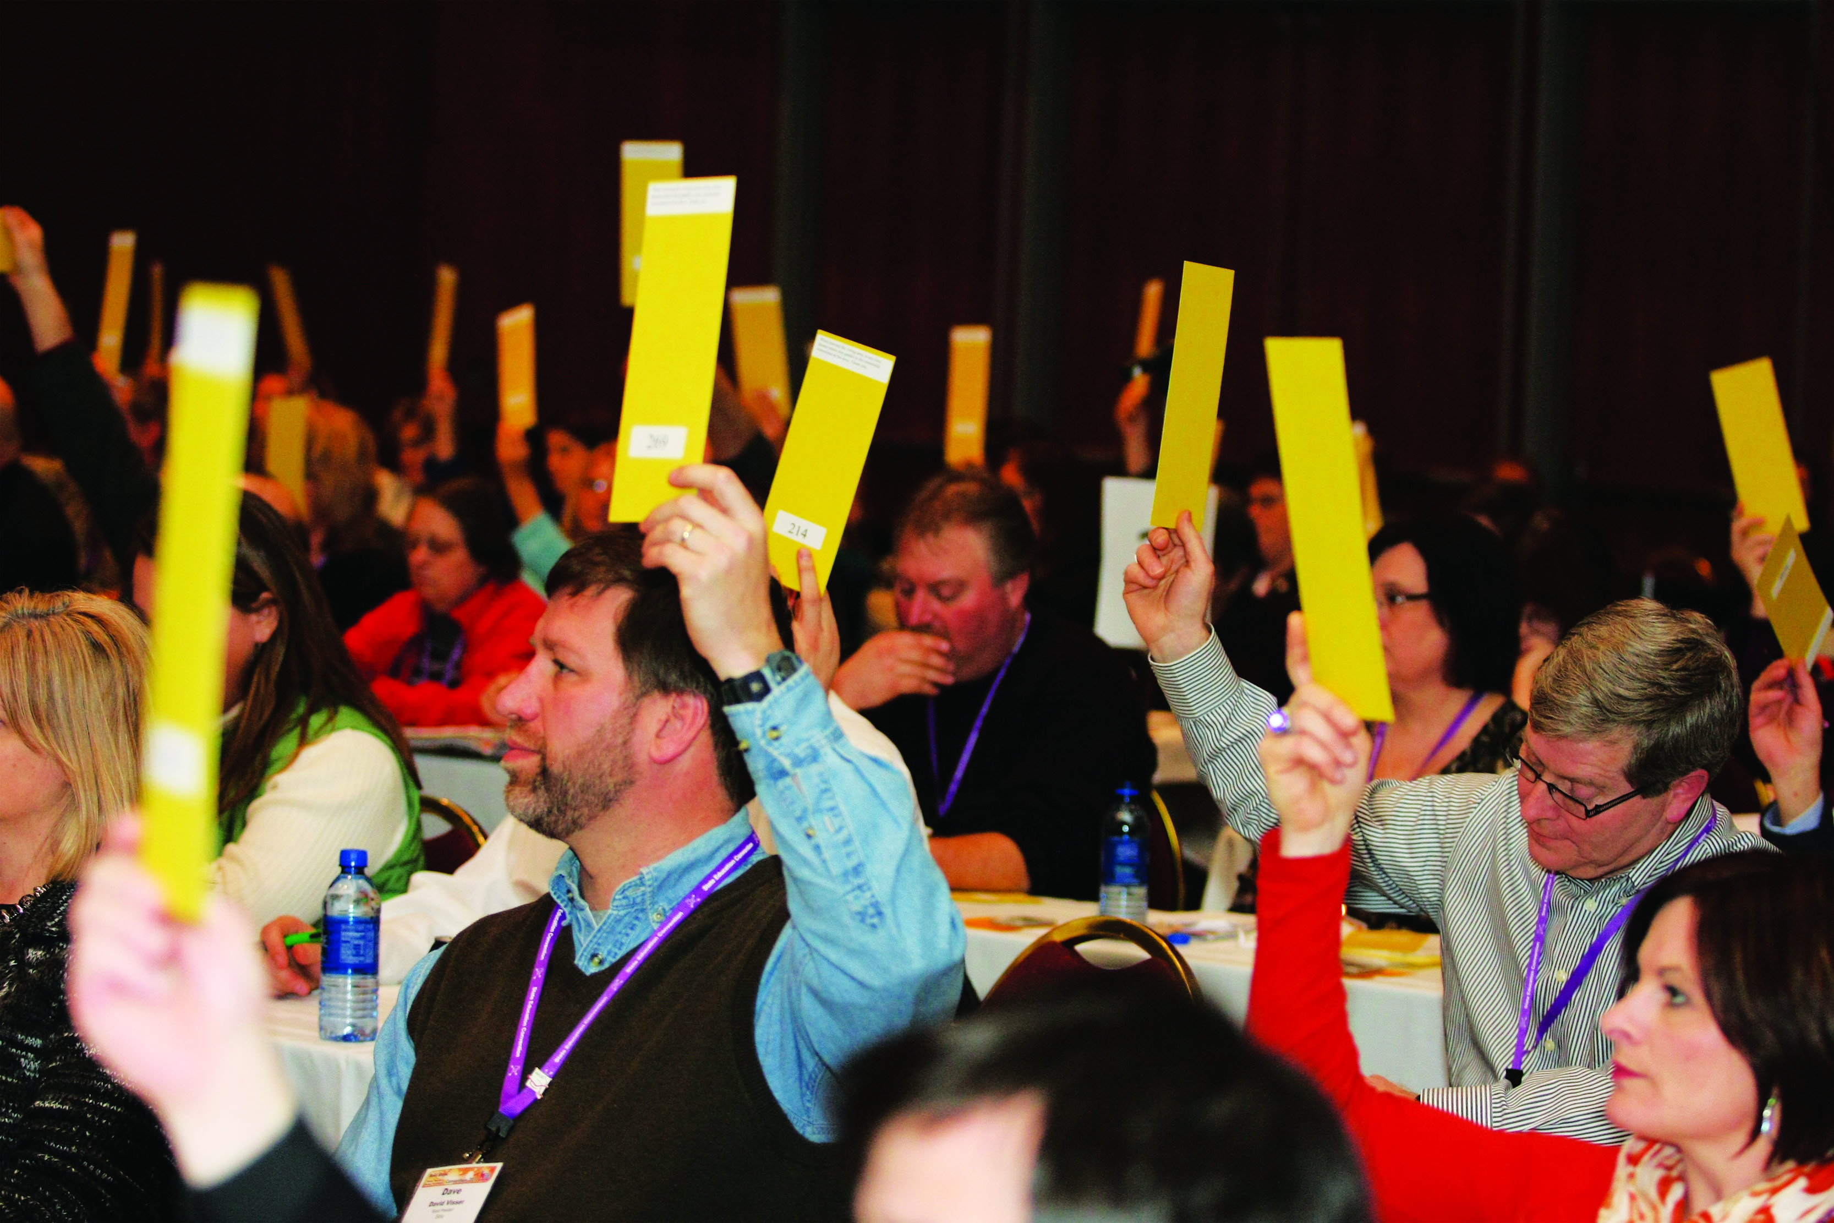
WASB Delegate Assembly
  Each member board has one vote on the policy positions determined at the annual WASB Delegate Assembly, held in conjunction with the State Education Convention.

Slide 36
Get to know the WASB … it is your Association!
Test your login ID and establish your personal password for the WASB website (www.wasb.org)
Consider attending WASB programs (upcoming programs are listed on the WASB website and promoted in various WASB publications)
Look for WASB materials to arrive by both email and
U.S. mail
Contact us directly via email (info@wasb.org) or telephone (toll-free: 1-877-705-4422)
WASB
122 W. Washington Ave., Suite 400
Madison, WI 53703
608-257-2622
877-705-4422 (toll-free)
wasb.org

Slide 37
© 2018
This presentation is a product of the Wisconsin Association of School Boards, Inc. This presentation is intended to provide authoritative general information, with commentary, as a service to WASB members. The materials and information provided in this presentation should not be relied upon as legal advice. If needed, legal advice regarding any topic, issue, situation or incident should be obtained from the school district's legal counsel.

